Slide 1
Meta-Analysis Models
Fixed-, Random-, and Equal-Effects Models
Study Weights

Slide 2
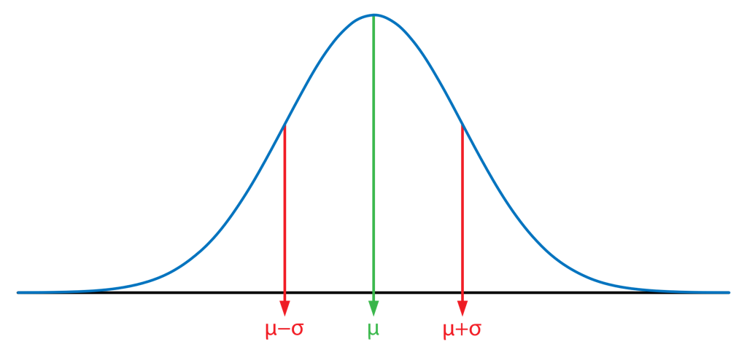
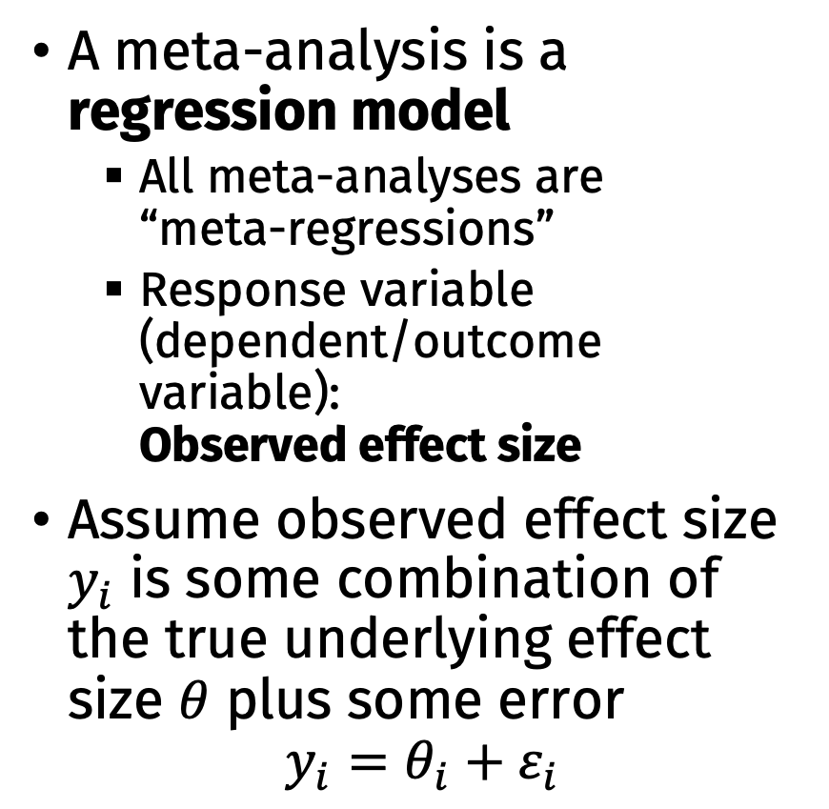
Basic Meta-Analysis Model
A meta-analysis is a regression model
All meta-analyses are “meta-regressions”
Response variable (dependent/outcome variable): Observed effect size
Assume observed effect size $y_{i}$ is some combination of the true underlying effect size $θ$ plus some error
$$y_{i}=θ_{i}+ε_{i}$$

Slide 3
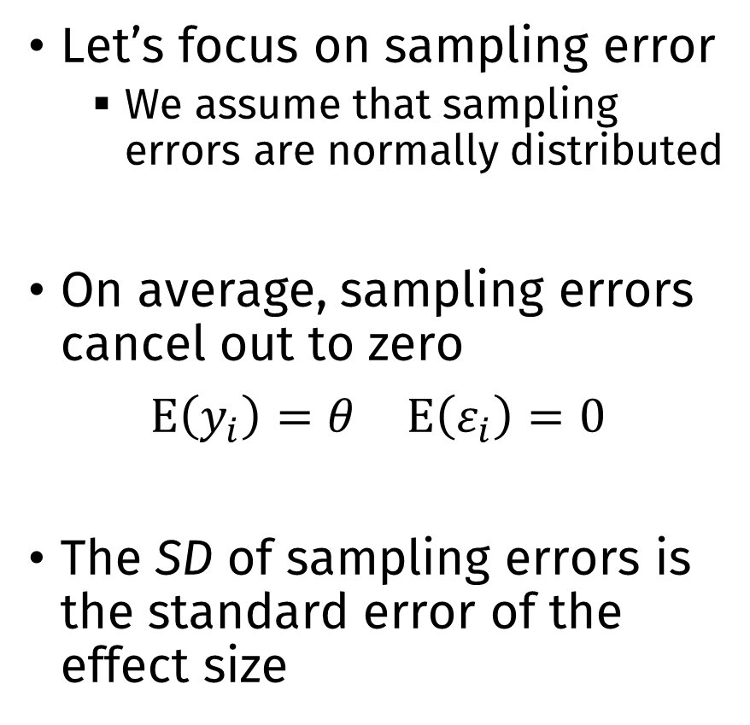
Basic Meta-Analysis Model
Let’s focus on sampling error
We assume that sampling errors are normally distributed
On average, sampling errors cancel out to zero
$E\left(y_{i}\right)=θ$ $E\left(ε_{i}\right)=0$
The SD of sampling errors is the standard error of the effect size

Slide 4
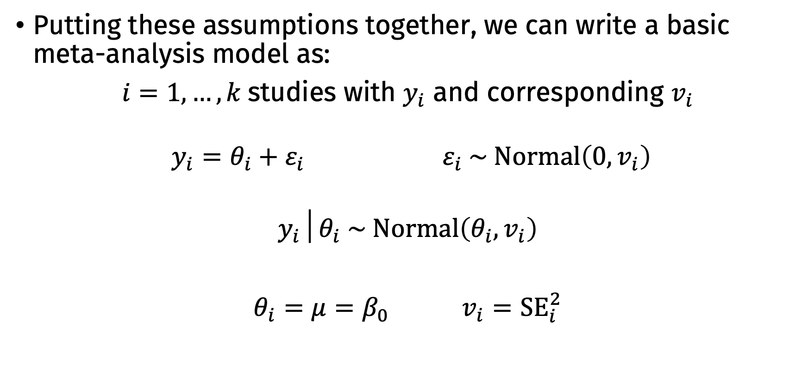
Basic Meta-Analysis Model
Putting these assumptions together, we can write a basic meta-analysis model as:
$i=1, …, k$studies with $y_{i}$ and corresponding $v_{i}$
$y_{i}=θ_{i}+ε_{i}$ $ε_{i} \sim Normal\left(0,v_{i}\right)$
$$y_{i}│θ_{i} \sim Normal\left(θ_{i},v_{i}\right)$$
$θ_{i}=μ=β_{0}$ $v_{i}={SE}_{i}^{2}$

Slide 5
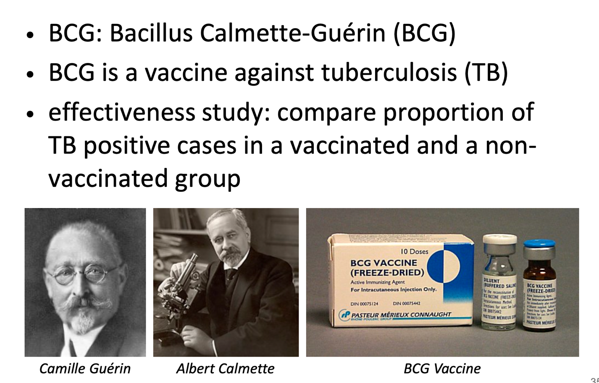
Example: BCG Vaccine

Slide 6
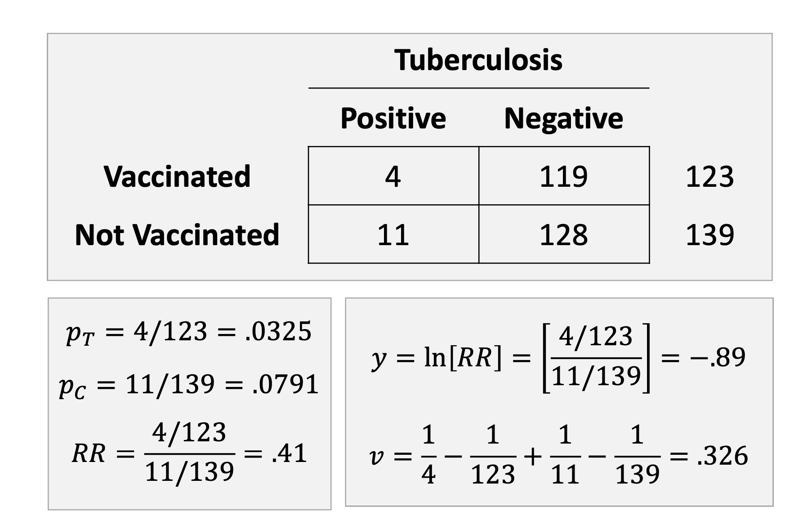

Slide 7
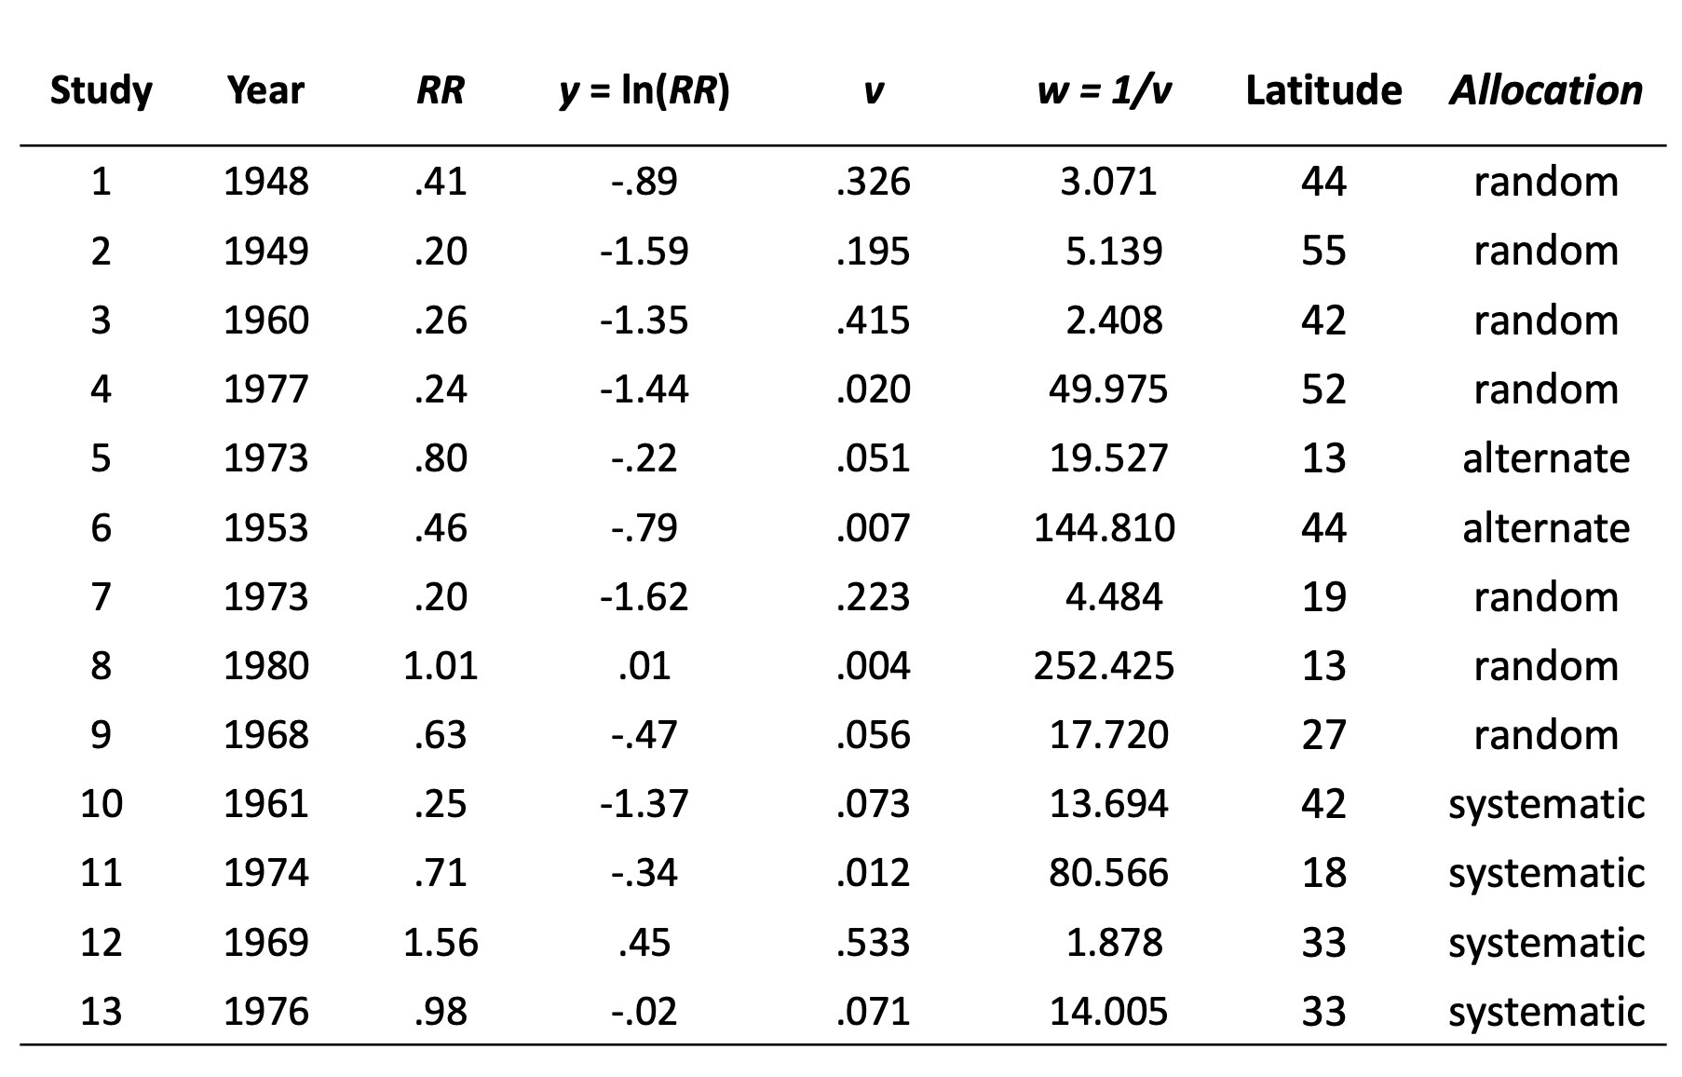
Example: BCG Vaccine

Slide 8
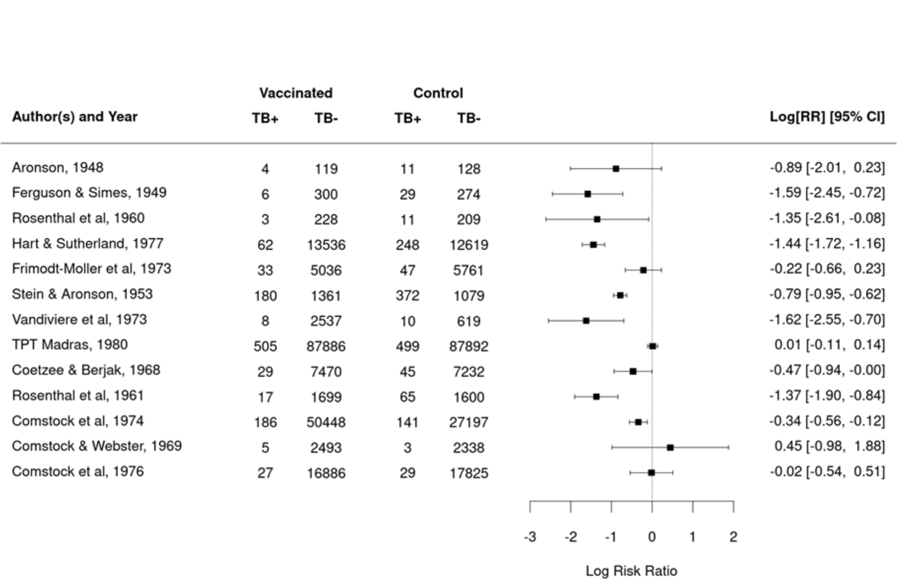
Example: BCG Vaccine Forest Plot

Slide 9
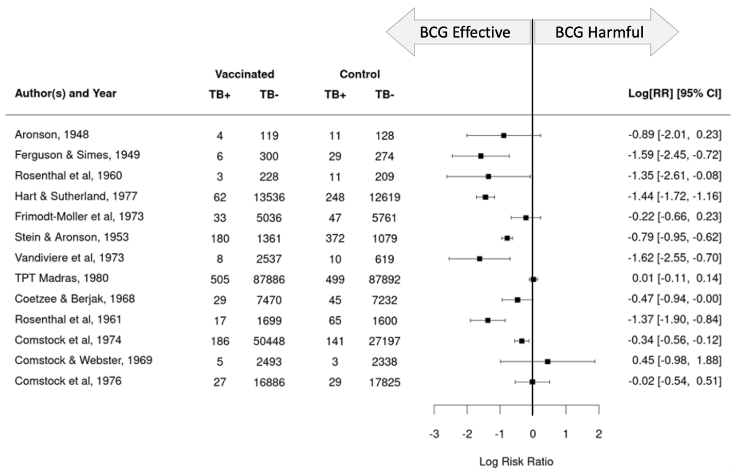
Example: BCG Vaccine Forest Plot

Slide 10
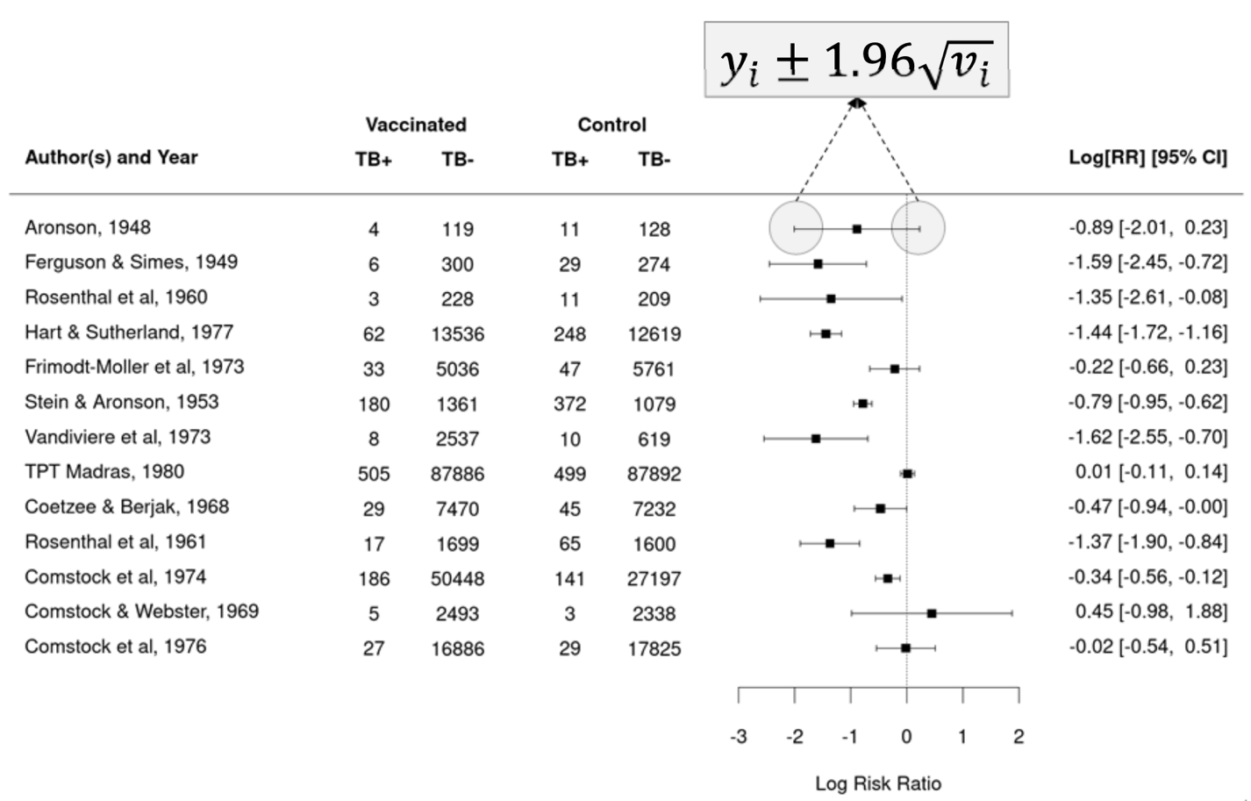
Example: BCG Vaccine Forest Plot

Slide 11
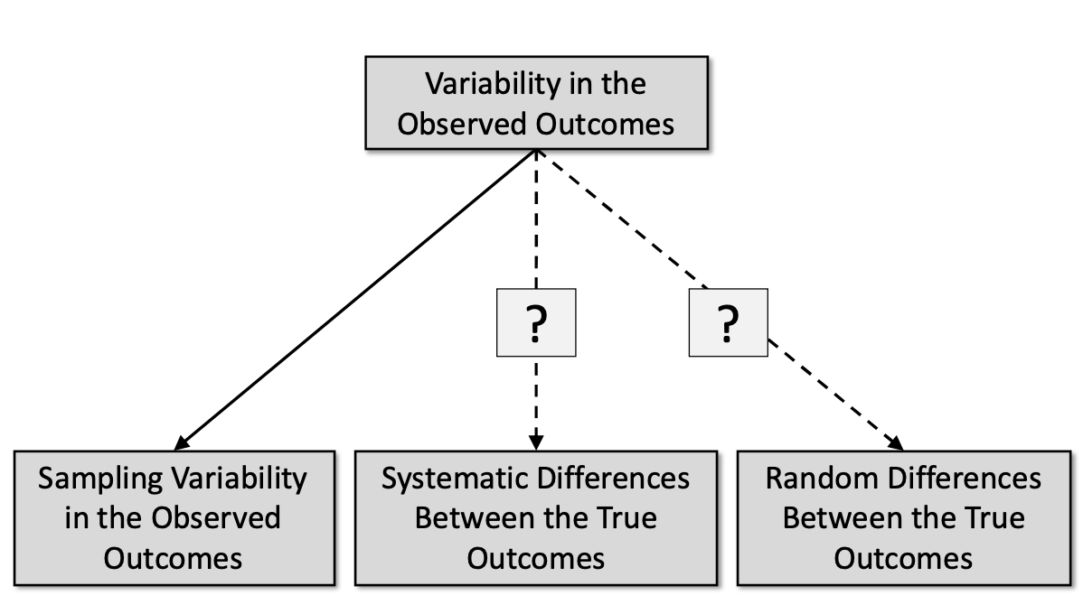
Why do these study outcomes differ?

Slide 12
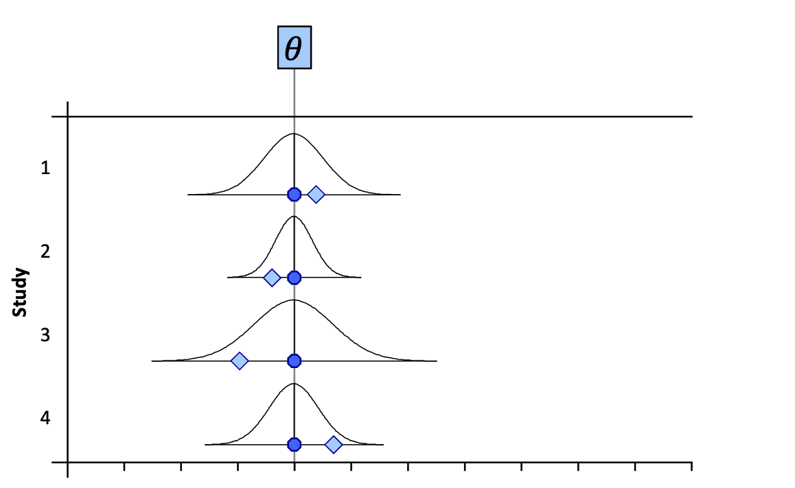
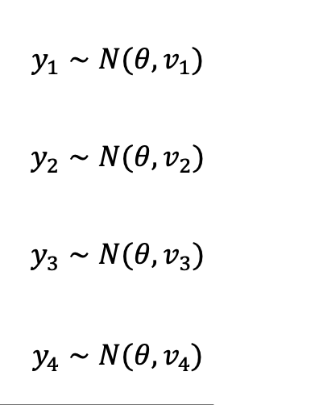
Equal Effects Model

Slide 13
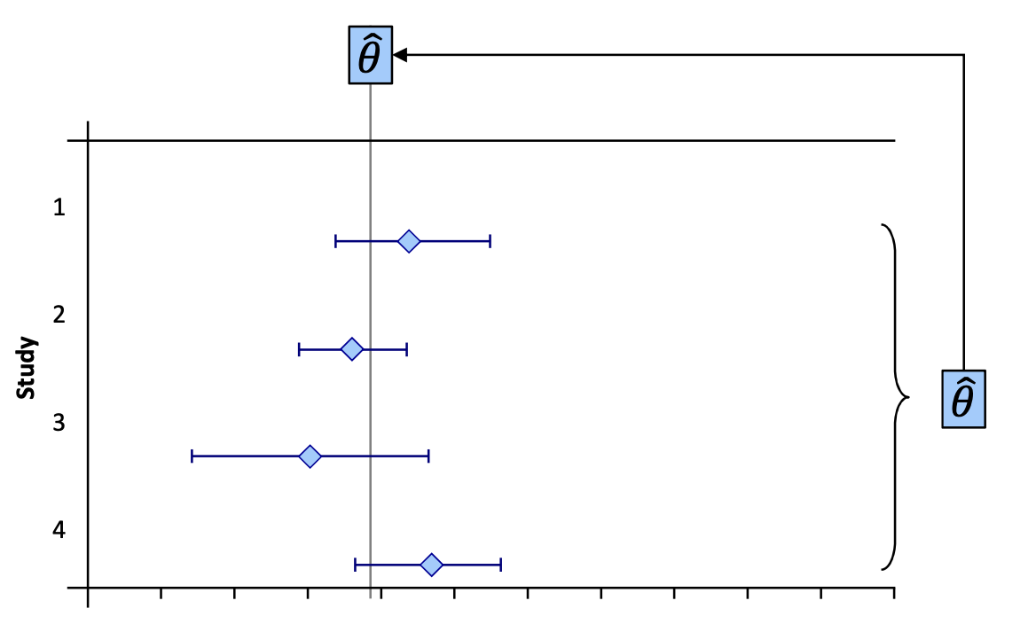
Equal Effects Model

Slide 14
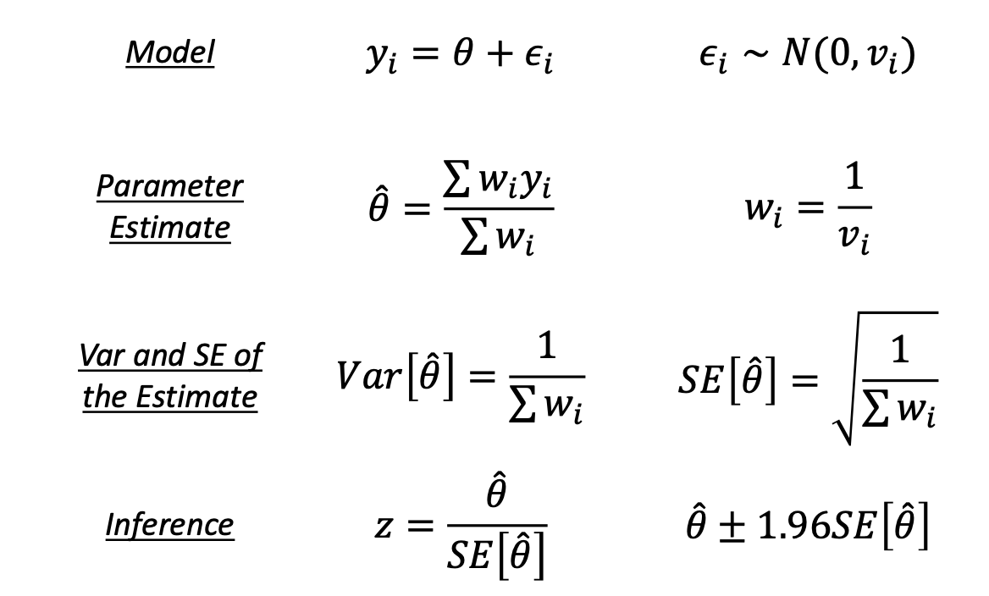
Equal Effects Model

Slide 15
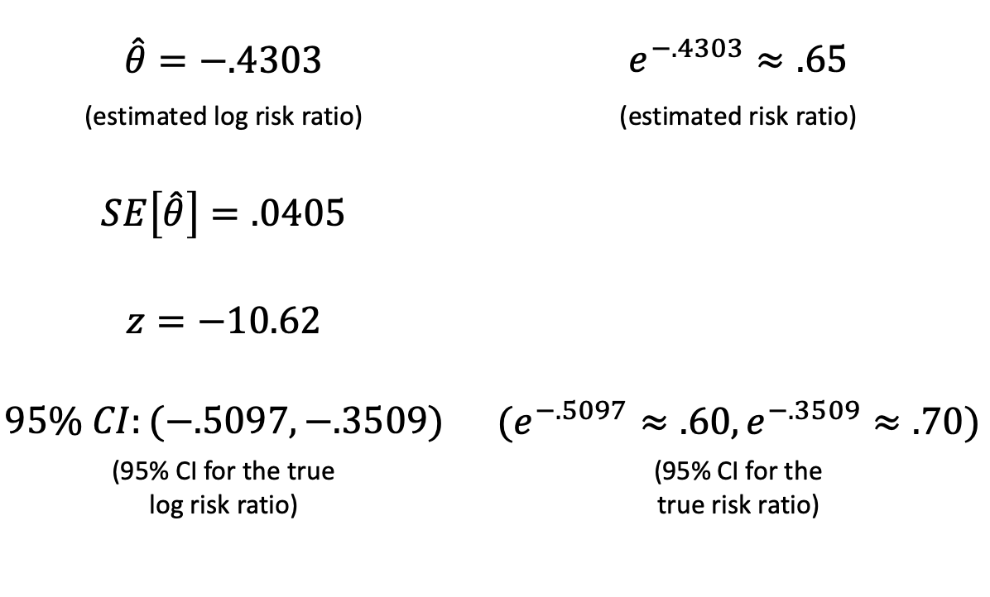
Equal Effects Model

Slide 16
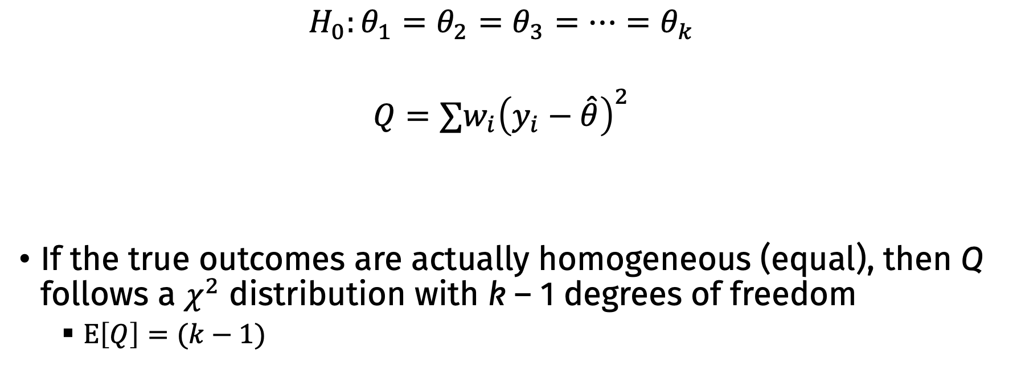
Testing for Heterogeneity
$$H_{0}:θ_{1}=θ_{2}=θ_{3}=…=θ_{k}$$
$$Q=∑w_{i}{\left(y_{i}−\hat{θ}\right)}^{2}$$
If the true outcomes are actually homogeneous (equal), then Q follows a $χ^{2}$ distribution with k – 1 degrees of freedom
$E\left[Q\right]=(k−1)$

Slide 17
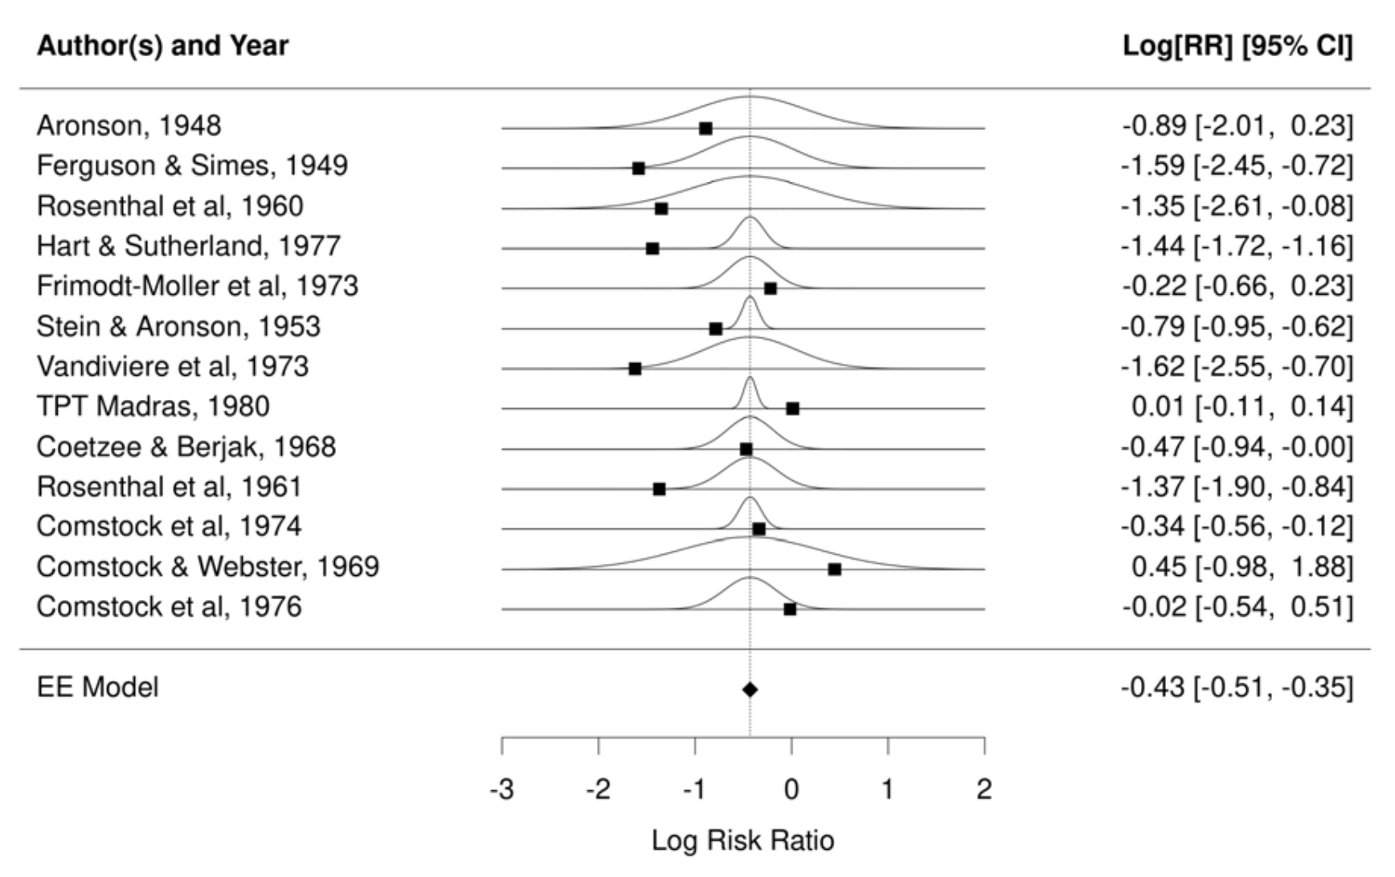

Slide 18
Example: BCG Vaccine
Q = 152.23
df = 12
For df = 12, α = .05 at 21.03
p < .0001
Is the equal effects model a good fit for these data?

Slide 19
Note: Do not use the Q test to choose a model
In general, I don’t think the Q test itself is useful
We should basically always assume that true outcomes are heterogeneous and model appropriately

Slide 20
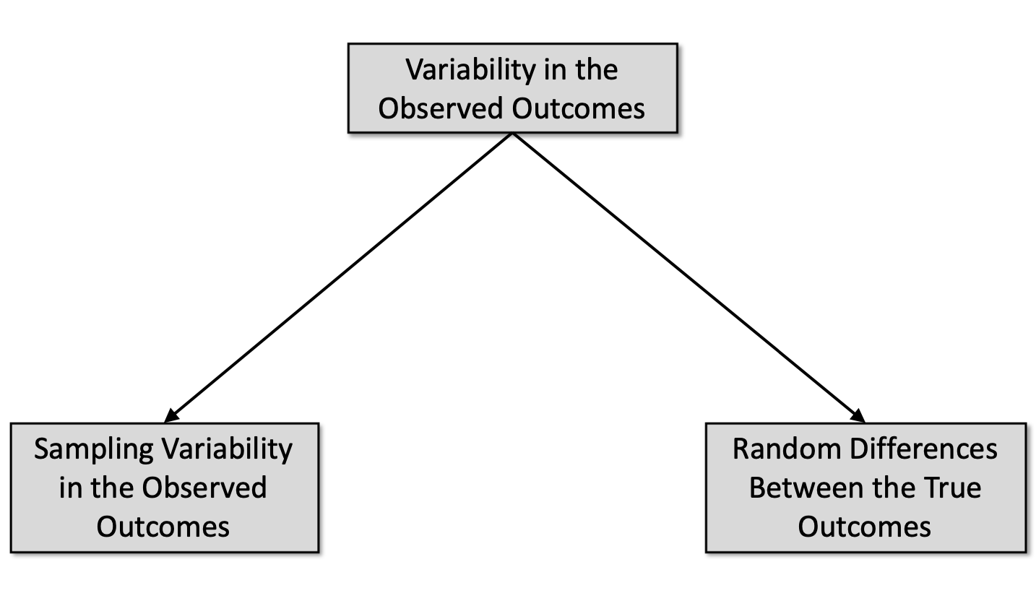
Why do these study outcomes differ?

Slide 21
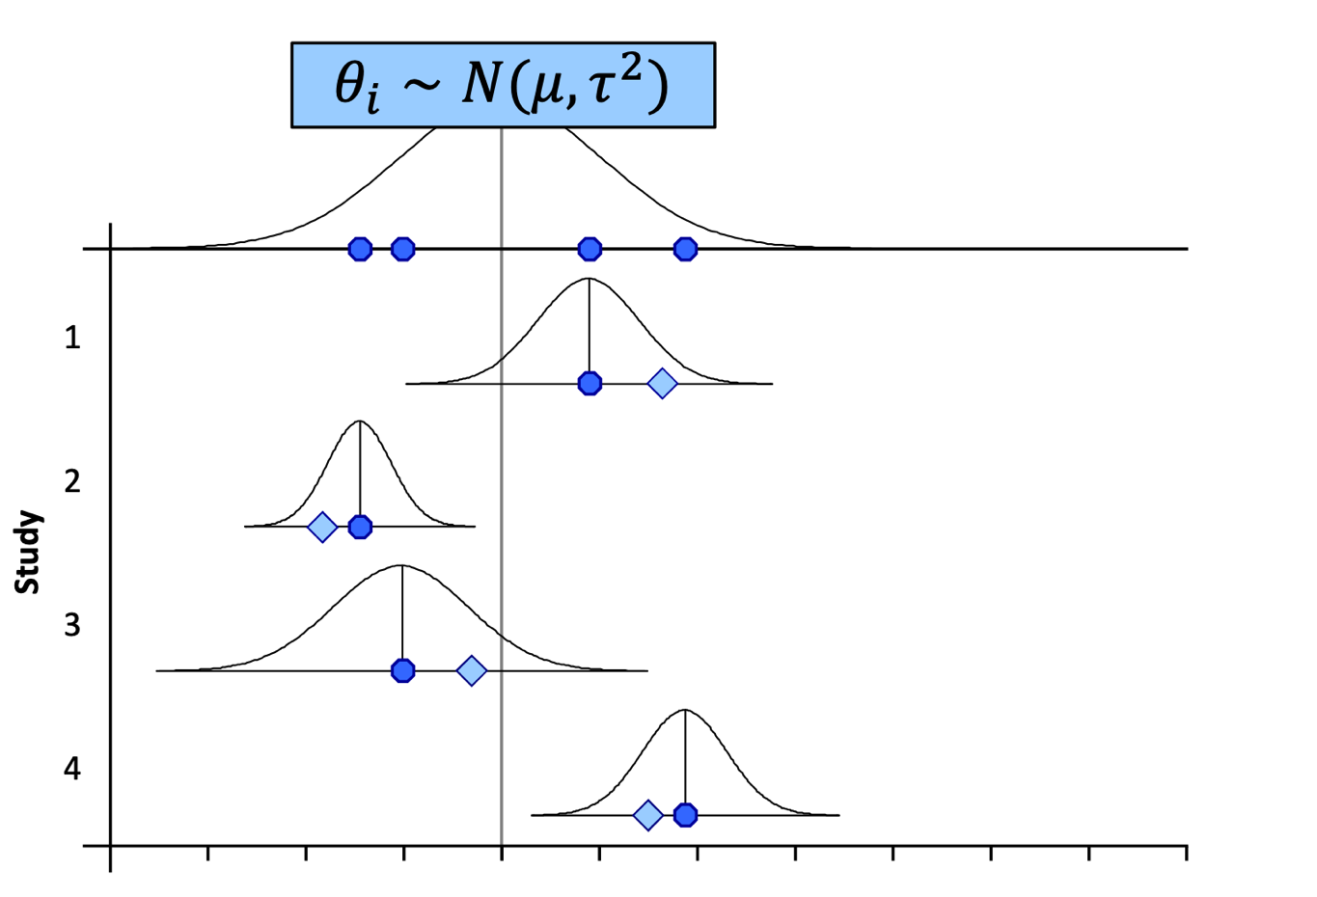
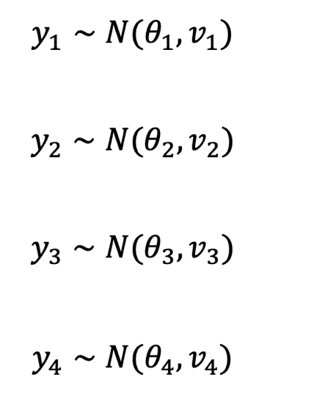
Random effects model

Slide 22
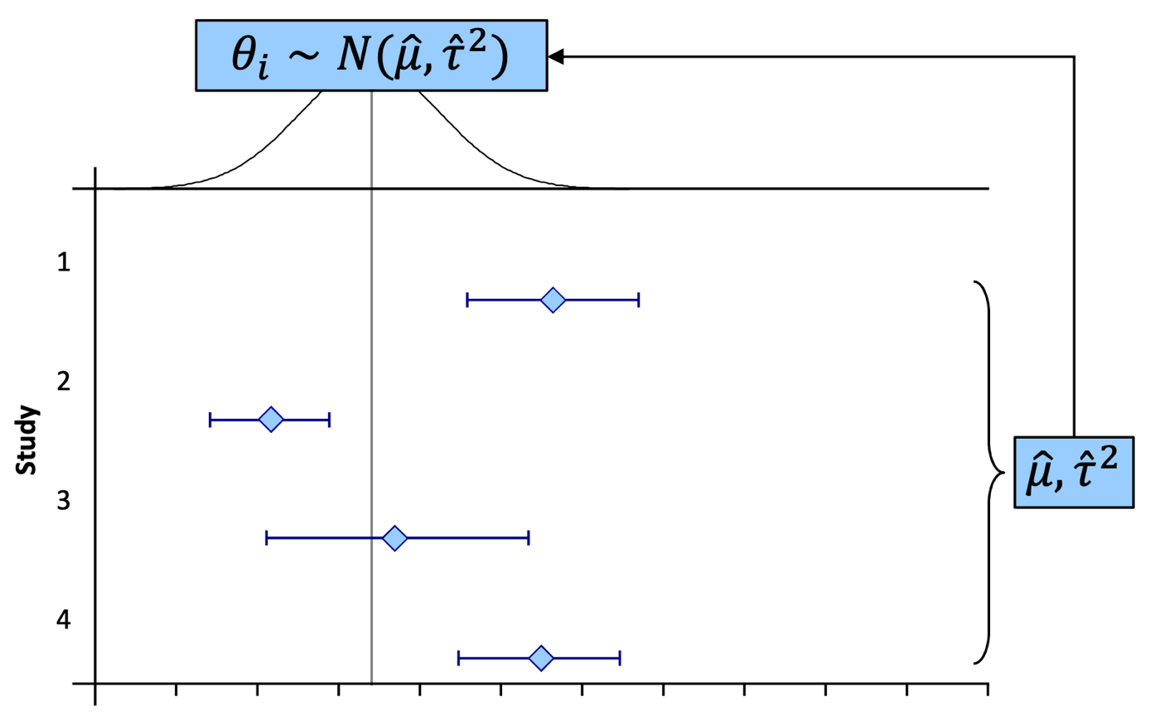
Random effects model

Slide 23
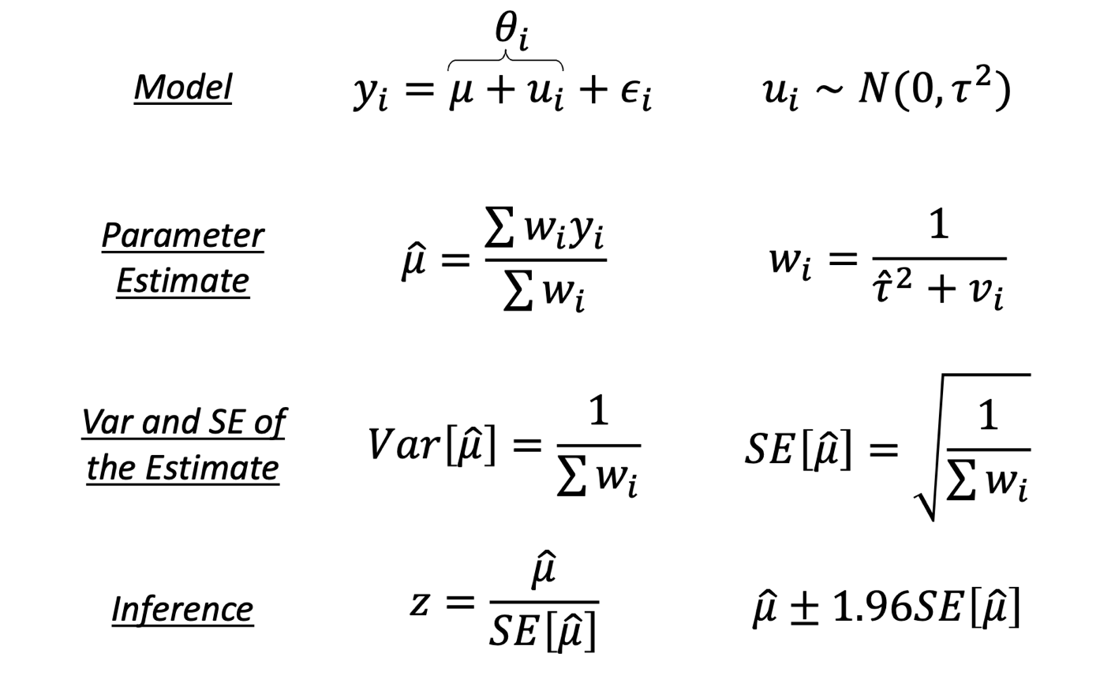
Random effects model

Slide 24
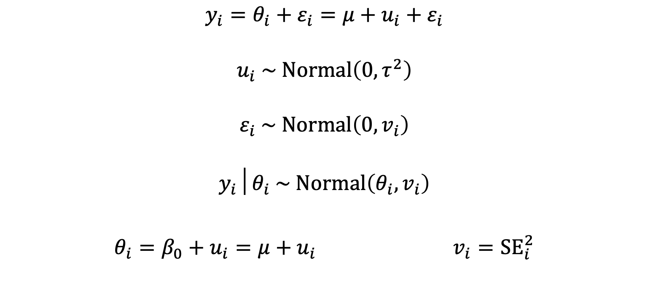
Random effects model
$$y_{i}=θ_{i}+ε_{i}=μ+u_{i}+ε_{i}$$
$$u_{i} \sim Normal\left(0,τ^{2}\right)$$
$$ε_{i} \sim Normal\left(0,v_{i}\right)$$
$$y_{i}│θ_{i} \sim Normal\left(θ_{i},v_{i}\right)$$
$θ_{i}=β_{0}+u_{i}=μ+u_{i}$ $v_{i}={SE}_{i}^{2}$

Slide 25
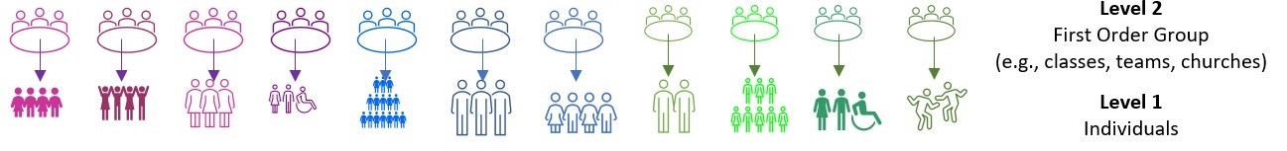
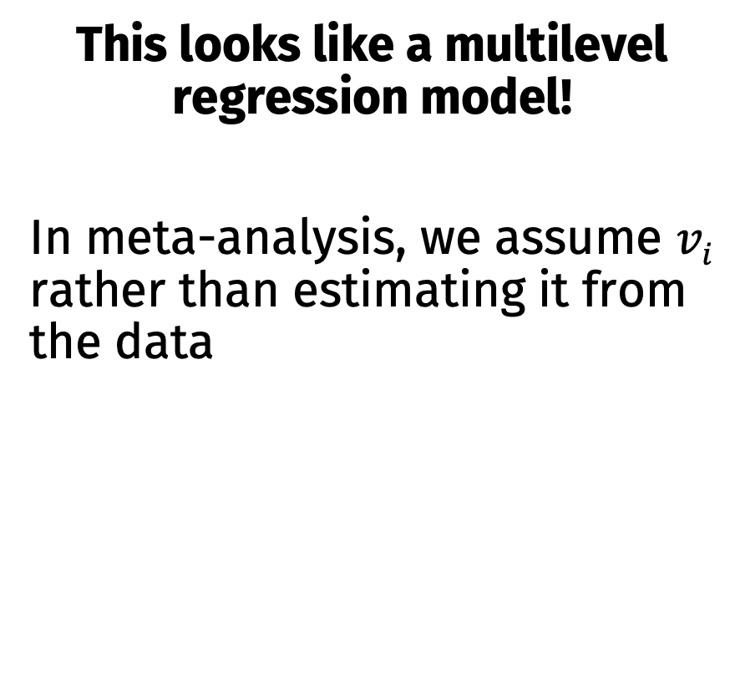
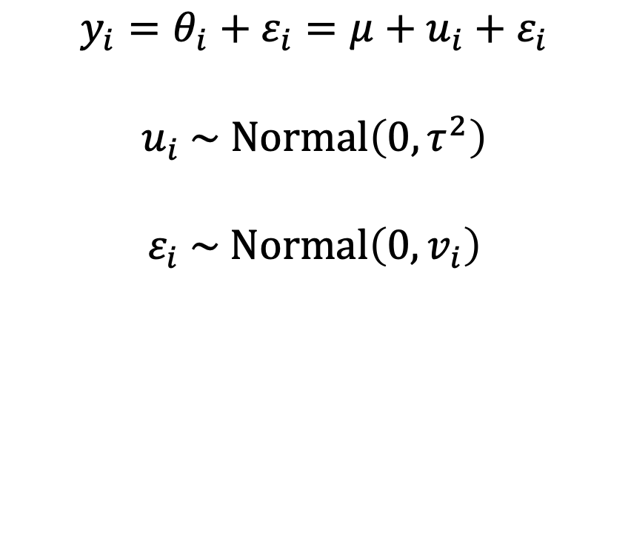
Random effects models as multilevel models
This looks like a multilevel regression model!
In meta-analysis, we assume $vi$ rather than estimating it from the data
$$y_{i}=θ_{i}+ε_{i}=μ+u_{i}+ε_{i}$$
$$u_{i} \sim Normal\left(0,τ^{2}\right)$$
$$ε_{i} \sim Normal\left(0,v_{i}\right)$$

Slide 26
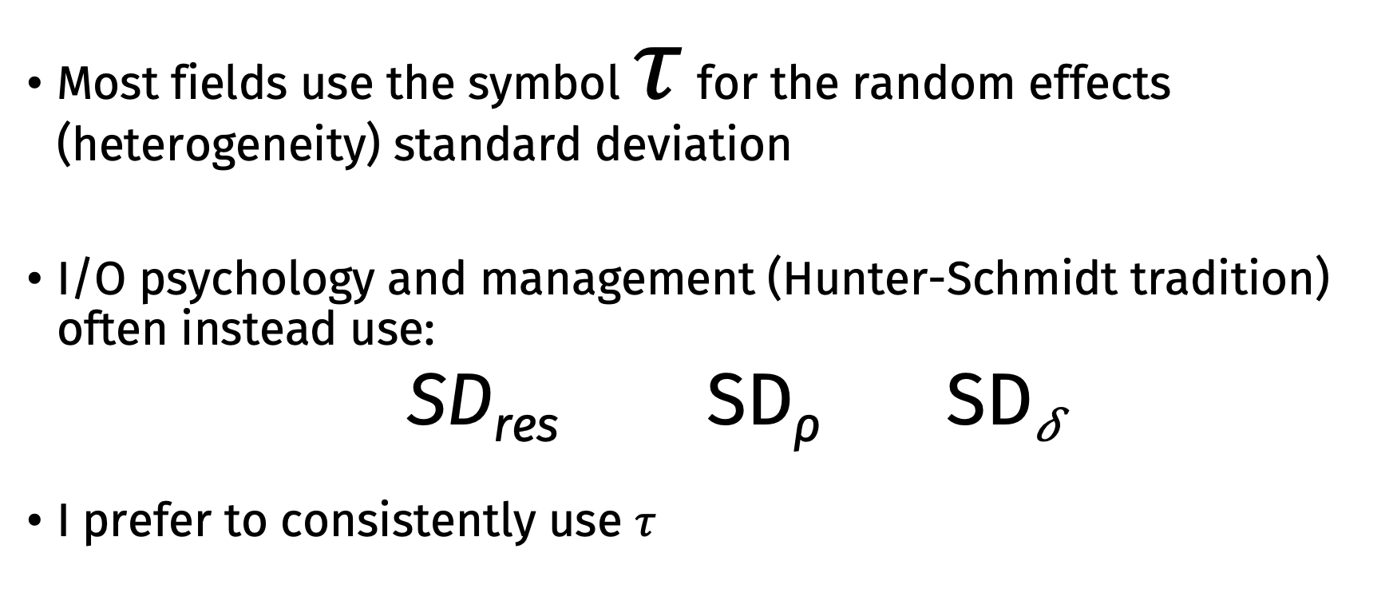
Terminology Note
Most fields use the symbol $τ$ for the random effects (heterogeneity) standard deviation
I/O psychology and management (Hunter-Schmidt tradition) often instead use:
SD_{res} SD_{ρ} SD_{𝛿}
I prefer to consistently use $τ$

Slide 27
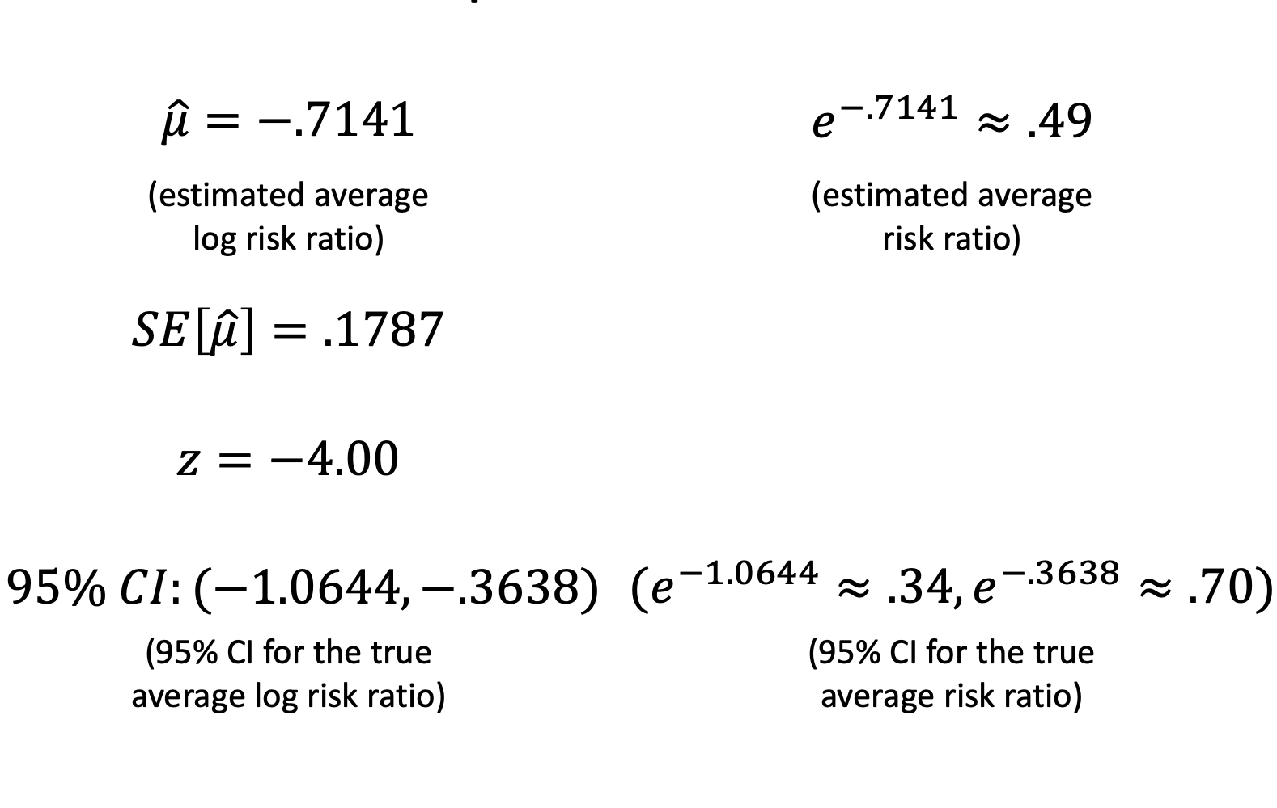
Example: BCG Vaccine

Slide 28
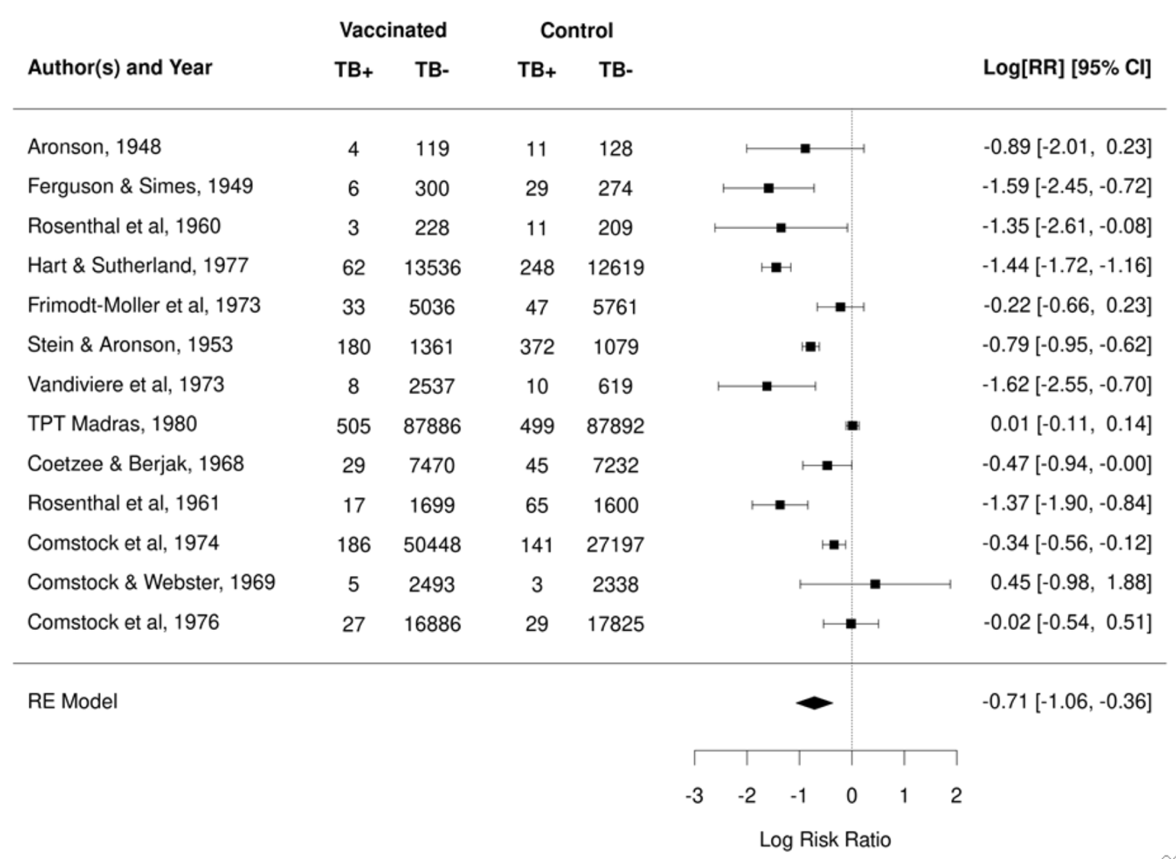

Slide 29
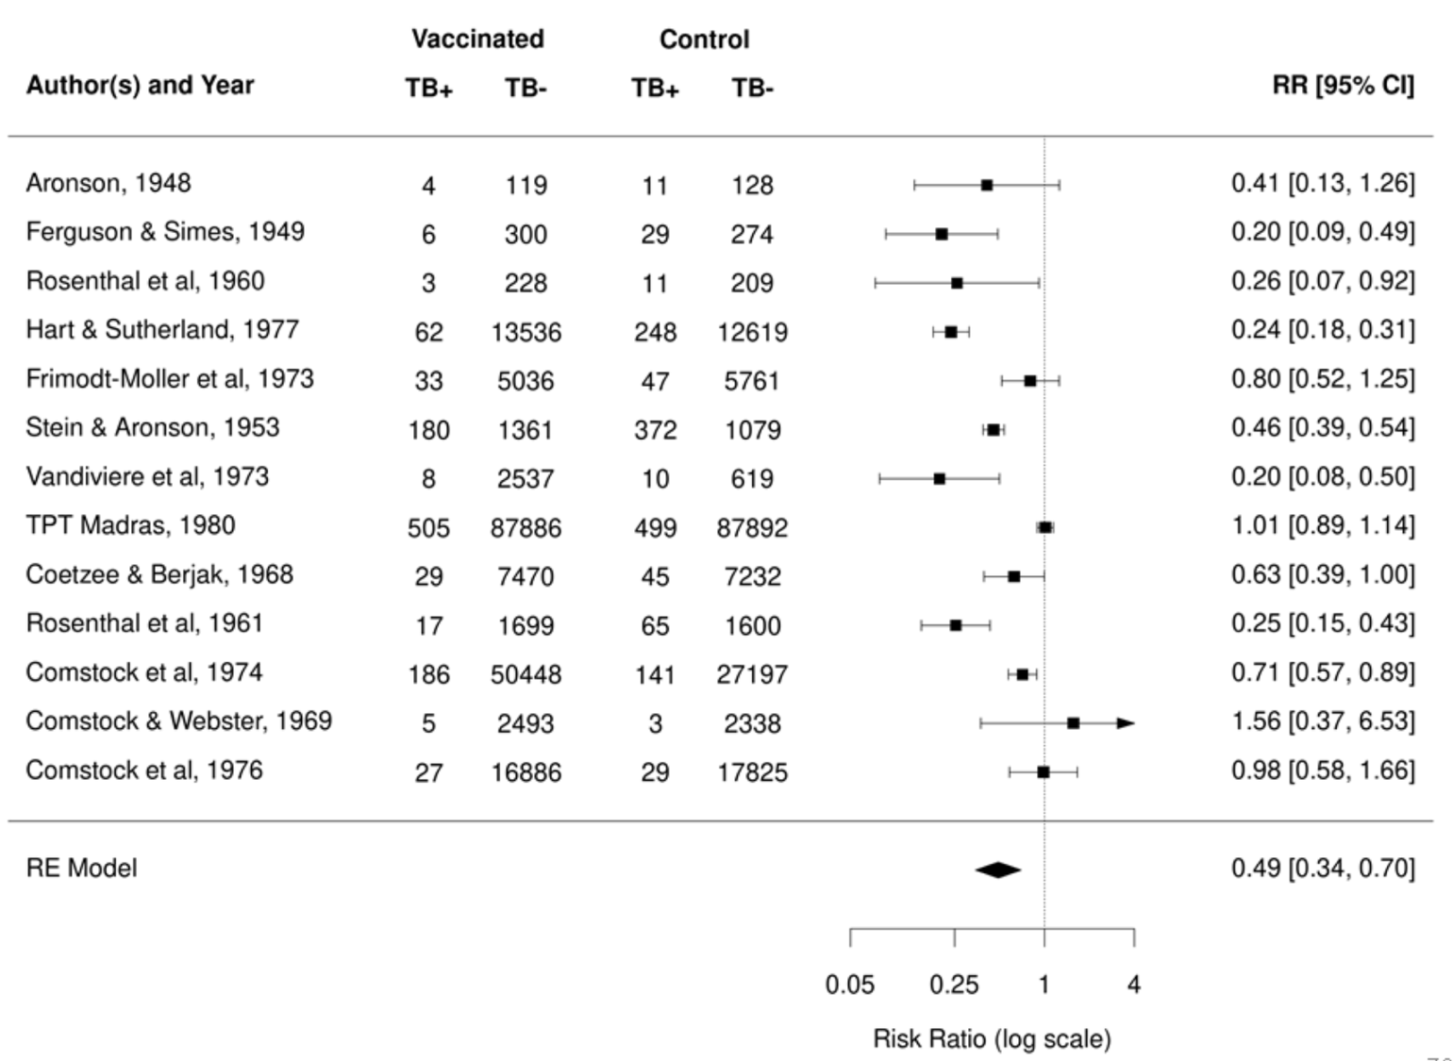

Slide 30
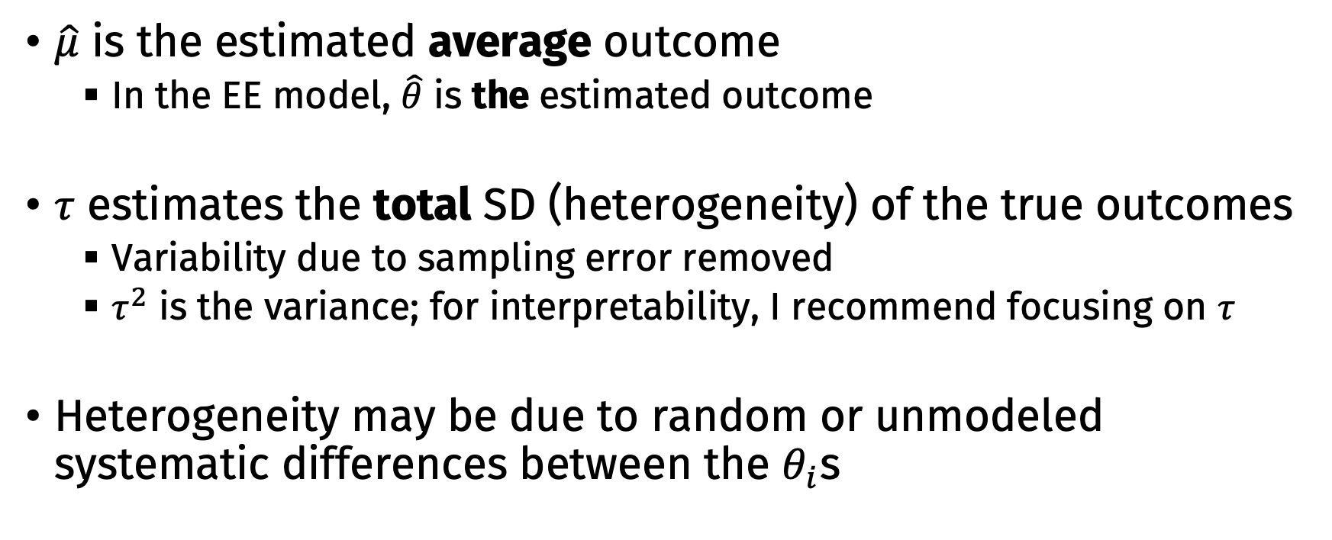
Interpreting RE model results
$\hat{μ}$ is the estimated average outcome
In the EE model, $\hat{θ}$ is the estimated outcome
$τ$ estimates the total SD (heterogeneity) of the true outcomes
Variability due to sampling error removed
$τ^{2}$ is the variance; for interpretability, I recommend focusing on $τ$
Heterogeneity may be due to random or unmodeled systematic differences between the $θ_{i}$s

Slide 31
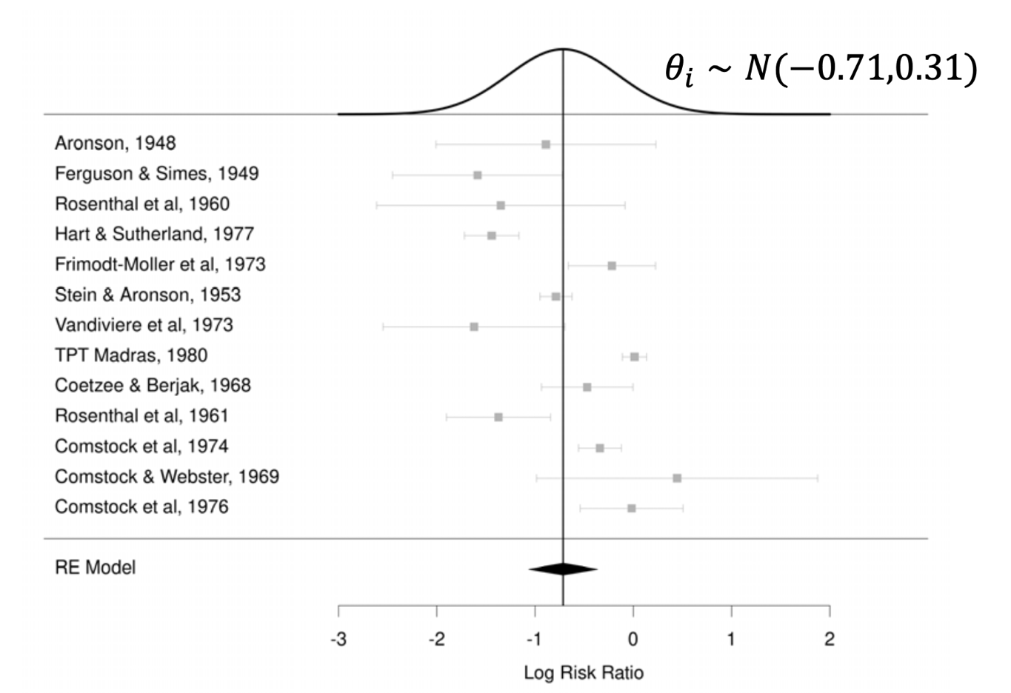
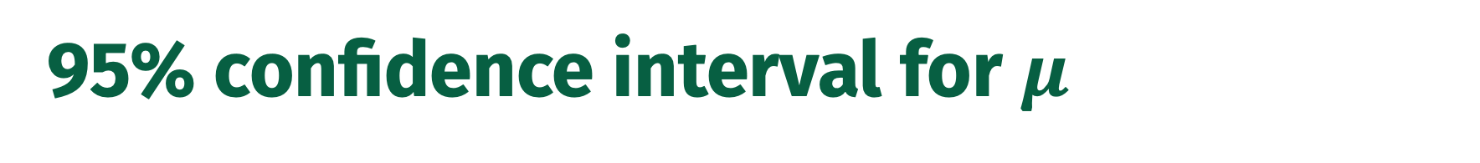
95% confidence interval for $μ$

Slide 32
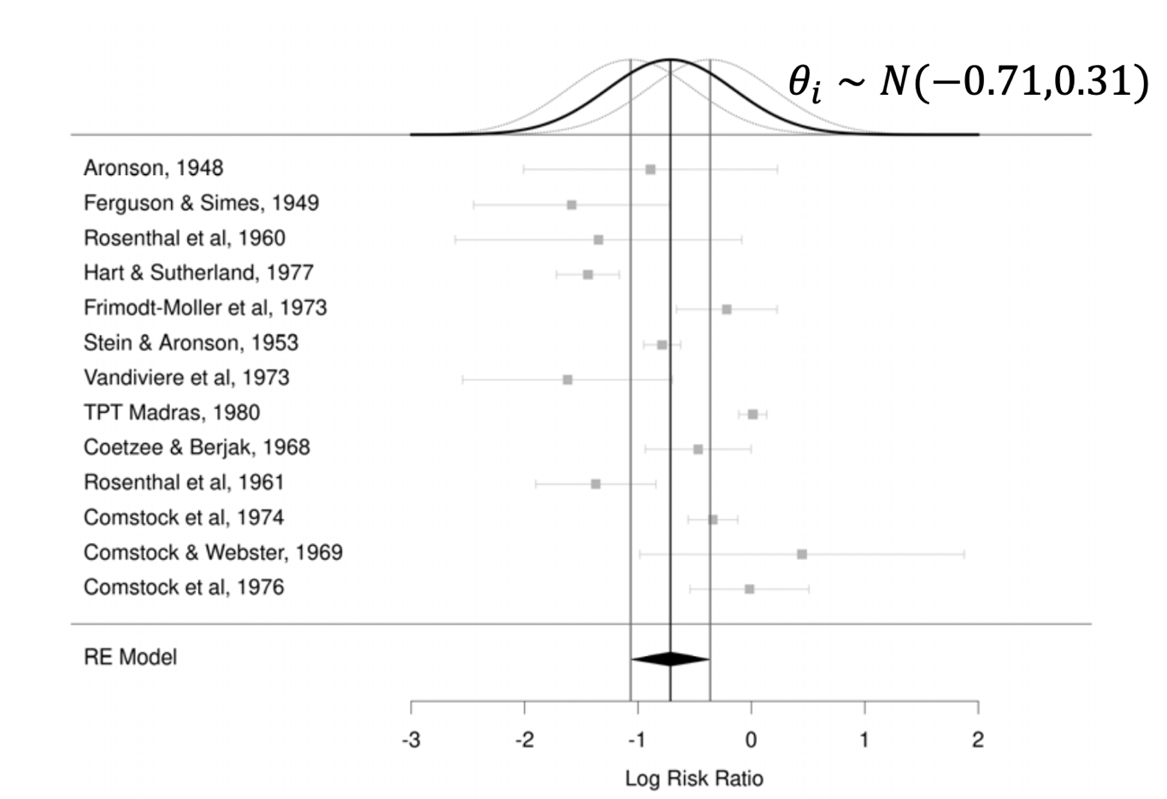
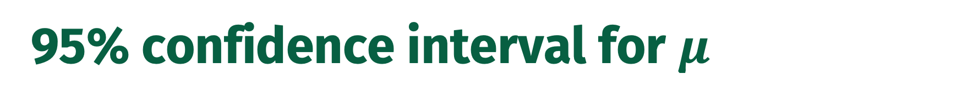
95% confidence interval for $μ$

Slide 33
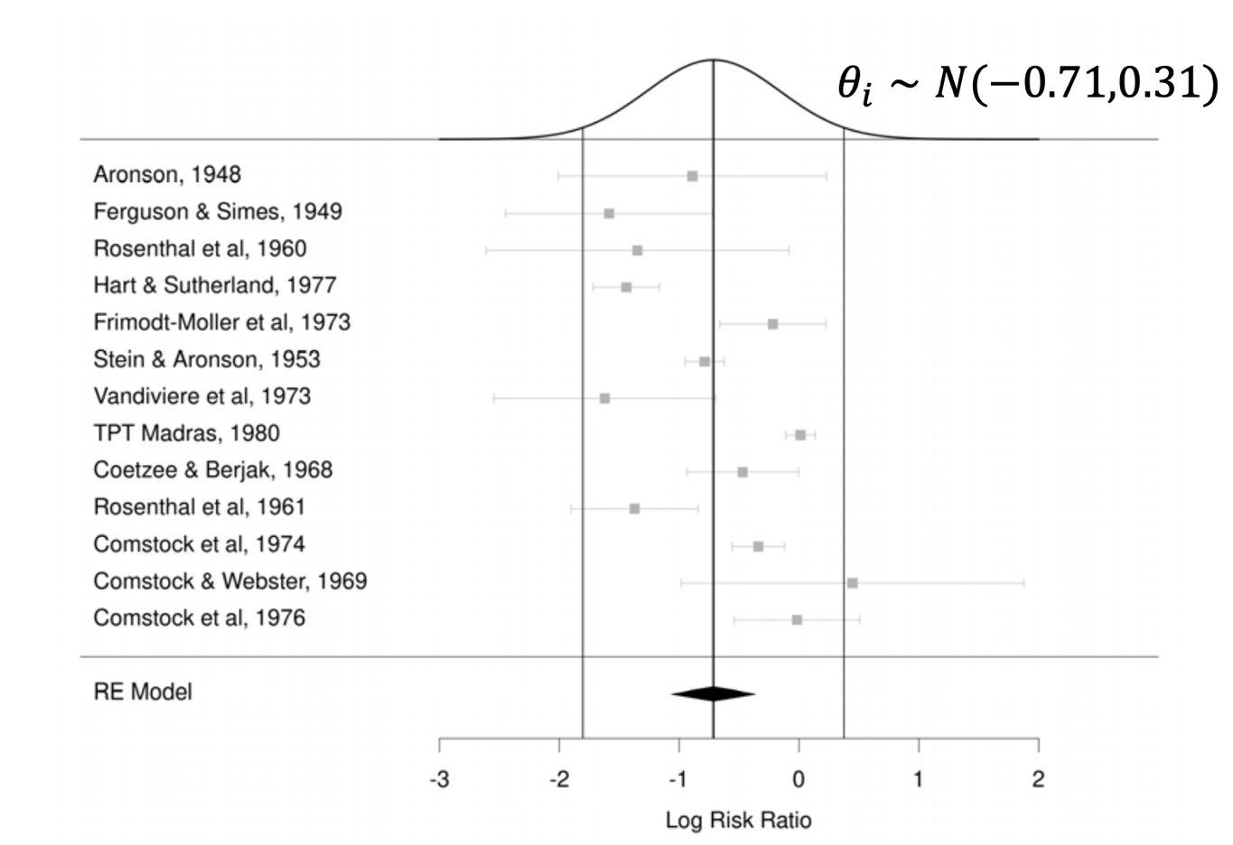
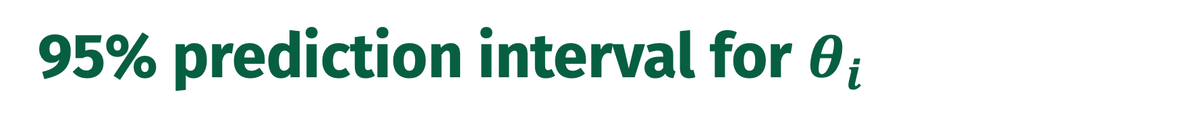
95% prediction interval for $θ_{i}$

Slide 34
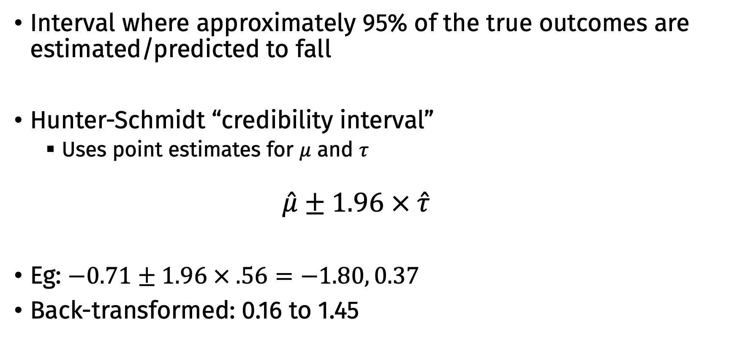
95% prediction interval for $θ_{i}$
Interval where approximately 95% of the true outcomes are estimated/predicted to fall
Hunter-Schmidt “credibility interval”
Uses point estimates for $μ$ and $τ$
$$\hat{μ}±1.96 × \hat{τ}$$
Eg: $−0.71±1.96 × .56=−1.80, 0.37$
Back-transformed: 0.16 to 1.45

Slide 35
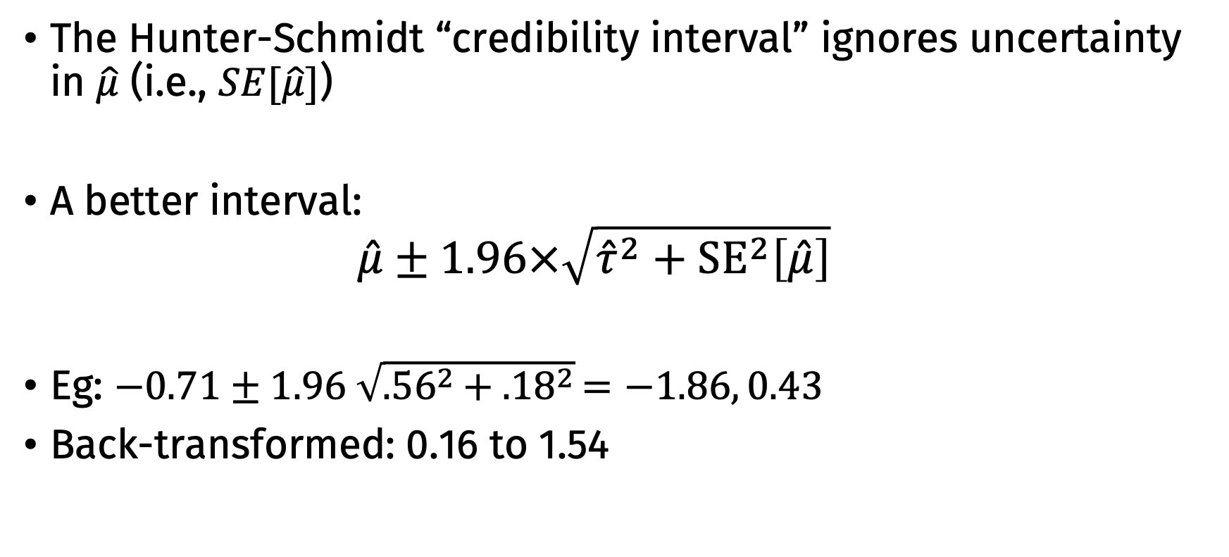
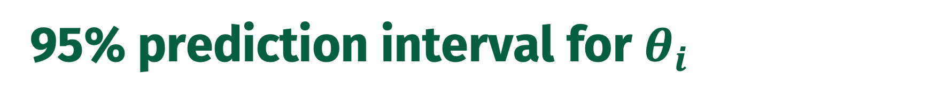
95% prediction interval for $θ_{i}$
The Hunter-Schmidt “credibility interval” ignores uncertainty in $\hat{μ}$ (i.e., $SE[\hat{μ}]$)
A better interval:
$$\hat{μ}±1.96×\sqrt{{\hat{τ}}^{2}+{SE}^{2}\left[\hat{μ}\right]}$$
Eg: $−0.71±1.96 \sqrt{{.56}^{2}+ {.18}^{2}}=−1.86, 0.43$
Back-transformed: 0.16 to 1.54

Slide 36
Fixed Effects Model
You often will see papers refer to a “fixed effects model”
This is usually a misnomer
They mean the equal effects model
Equal-effects model (EE)
Assume all samples have same true effect size
No heterogeneity
Only source of variability is sampling error
Can test if this is a reasonable assumption

Slide 37
Fixed, Random, and Equal Effects Models
Equal-effects model (EE)
Assume all samples have same true effect size
No heterogeneity
Only source of variability is sampling error
Can test if this is a reasonable assumption
Fixed-effects model (FE)
Does not assume all samples have same true effect size!
Use FE when you are only interested in the included samples
What is the mean of these samples?
Not generalizing to a broader population
Estimated using the same formulas as EE

Slide 38
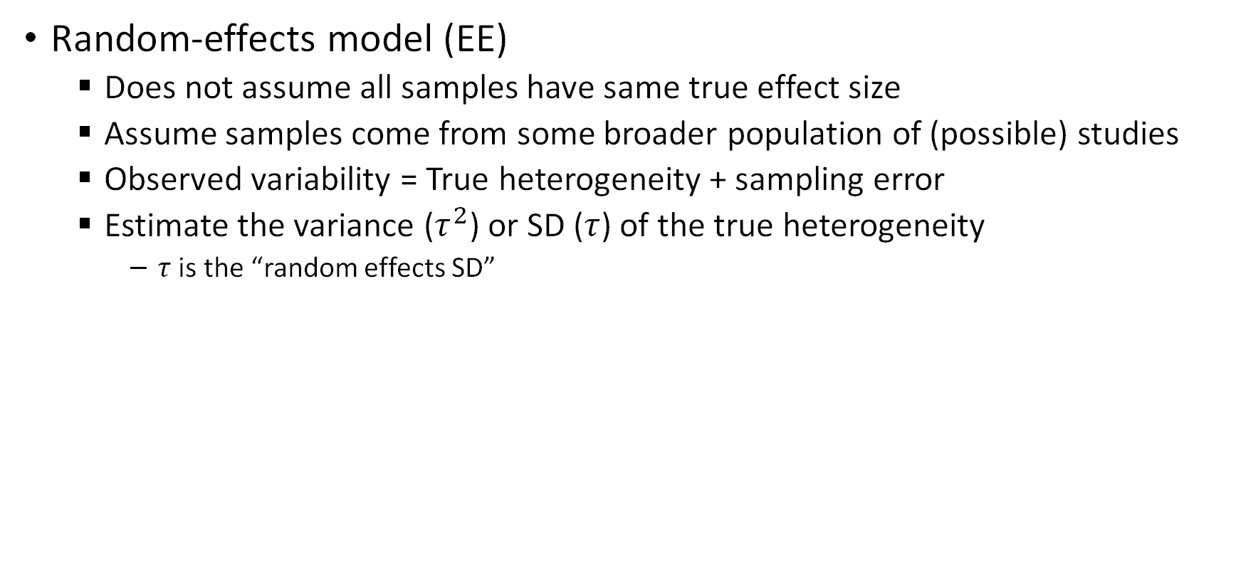
Fixed, Random, and Equal Effects Models
Random-effects model (EE)
Does not assume all samples have same true effect size
Assume samples come from some broader population of (possible) studies
Observed variability = True heterogeneity + sampling error
Estimate the variance ($τ^{2}$) or SD ($τ$) of the true heterogeneity
$τ$ is the “random effects SD”

Slide 39
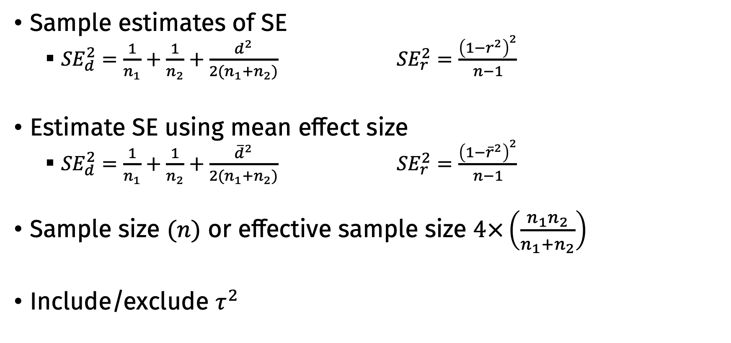
Choices of weights
Sample estimates of SE
${SE}_{d}^{2}=\frac{1}{n_{1}}+\frac{1}{n_{2}}+\frac{d^{2}}{2(n_{1}+n_{2})}$ ${SE}_{r}^{2}=\frac{{\left(1−r^{2}\right)}^{2}}{n−1}$
Estimate SE using mean effect size
${SE}_{d}^{2}=\frac{1}{n_{1}}+\frac{1}{n_{2}}+\frac{{\overline{d}}^{2}}{2(n_{1}+n_{2})}$ ${SE}_{r}^{2}=\frac{{\left(1−{\overline{r}}^{2}\right)}^{2}}{n−1}$
Sample size $(n)$ or effective sample size $4×\left(\frac{n_{1}n_{2}}{n_{1}+n_{2}}\right)$
Include/exclude $τ^{2}$

